Slide 1
New York City School Bus Delays
Hyejeong Lee, Kunal Shukla, Anupriya Thirumurthy, Yingkun Zhu
Prepared for NYC Department of Transportation & Education Master of Science in Analytics, University of Chicago
August 24, 2018

Slide 2
Agenda
Project Overview
Problem Statement
Dataset Overview & Context
Data Pre-Processing & Visualization
Analysis and Insights
Latent Class Analysis
Classification and Regression Tree
Negative Binomial Regression
Recommendations and Future Work

Slide 3
Problem Statement
Stakeholders - NYC Departments of Transportation and Education
Problem Statement
Provide actionable insights for DoT to reduce NYC School Bus Delays
Understand the factors which impact School Bus delays
Source: http://arun-aiml.blogspot.com/2017/07/k-means-clustering.html

Slide 4
Dataset - Overview
Source - https://data.cityofnewyork.us/Transportation/Bus-Breakdown-and-Delays/ez4e-fazm
Time frame - September 30, 2015 to July 1, 2018
Description - Bus vendor staff report delays / breakdowns during routes
Data primarily consists of delays due to heavy traffic
Analysis focuses on K-12 routes (Pre-K routes operate under a different structure)
Data fields include
Run Type
Bus Vehicle Type
Bus garage location
Borough where delay is reported
School Location
Timestamp of when delay is reported
Number of students on bus when delay is reported

Slide 5
Dataset - Context
Delays occur in transit, only Borough is reported
Bus leaves garage in morning
Bus picks up students
Bus drops students off at school
Precise location of garage is known
For privacy reasons, pick-up locations are not provided
Precise location of school is known

Slide 6
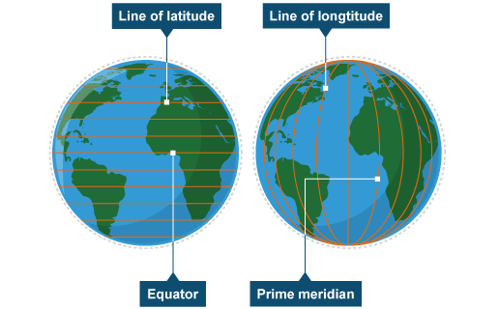
Data Pre-Processing
One model uses distance between bus garage and school location as an input variable
Bus garage location is provided as spatial coordinates
School location is provided as Latitude / Longitude
To compute distance accurately, need to project school location onto 2D coordinate system
Universal Transverse Mercator (UTM) projection
Image Source: http://www.bbc.co.uk/bitesize/ks3/geography/geographical_enquiry/geographical_skills/revision/6/

Slide 7
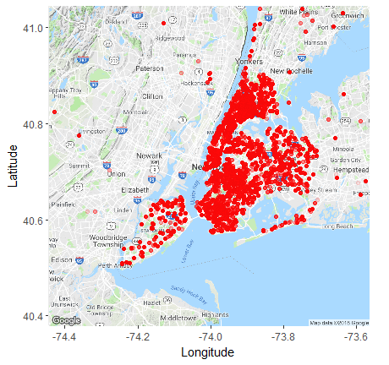
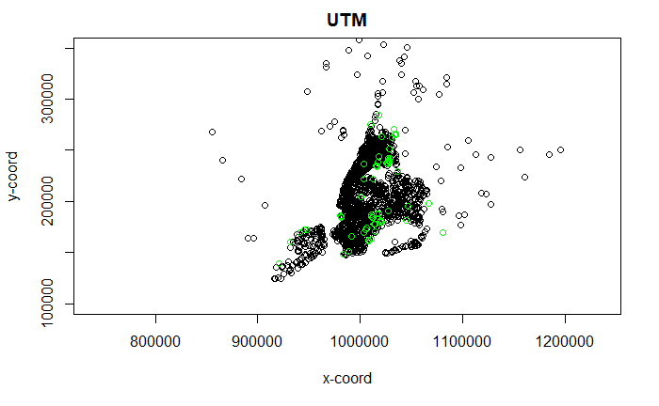
Spatial Data Visualization
Before - Longitude/Latitude Scale
After - UTM Scale

Slide 8
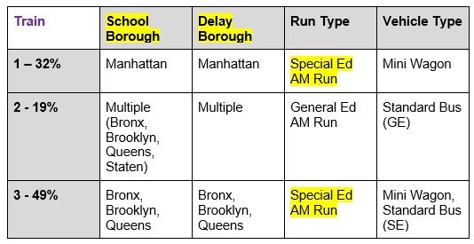
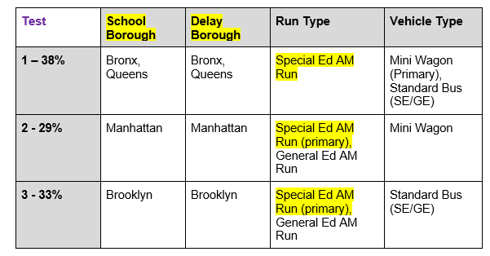
Latent Class Analysis
In-Scope Observations: ~135k
Goal - Identify major segments of delays
Variables used - Borough of School, Run Type, Vehicle Type, Borough of Delay
Results
Delays primarily occur in the same Borough where the school is located
Special Ed AM Runs make up the majority of delays (curb-to-curb service)
Source: http://arun-aiml.blogspot.com/2017/07/k-means-clustering.html

Slide 9
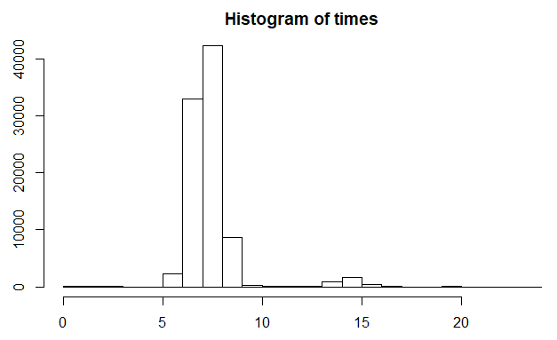
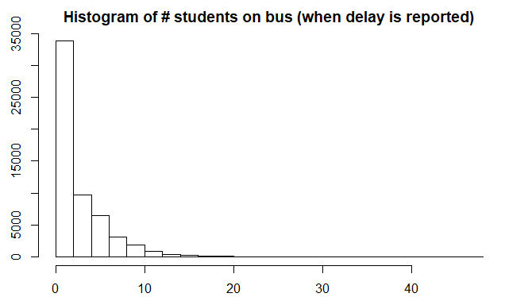
LCA - Insights
Filtering on Special Ed AM Runs, we observe:
Majority of delays occur before or during rush hour
Majority of delays are reported when there are zero students on the bus
Source: http://arun-aiml.blogspot.com/2017/07/k-means-clustering.html

Slide 10
Classification and Regression Tree
In-Scope Observations: ~60k
Filtered on Special Ed AM Run Delays
Goal - Understand the factors which lead to a delay in each borough
Variables used
Original Variables
School Affiliation (Public, Charter, etc.)
Borough of delay (leaves / terminal nodes)
Meta Features
Distance between garage and school
Bus Garage in same borough as delay (Indicator Variable)
Zero Students on Bus (Indicator Variable)

Slide 11
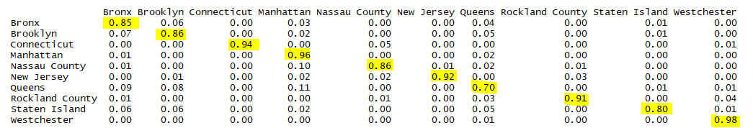
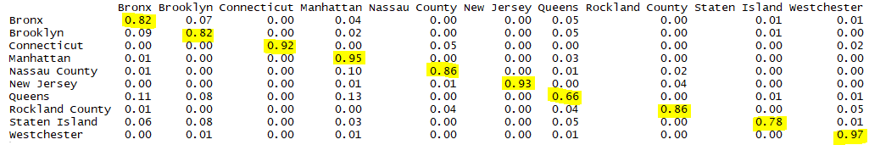
While the CART solution has relatively high sensitivity and is stable...
Train
Test

Slide 12
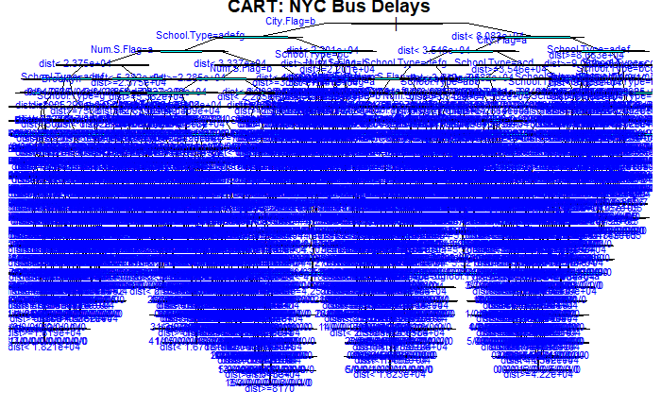
...the CART solution is impossible to visualize

Slide 13

CART - Insights
Although the tree is difficult to visualize, looking at variable importance with regards to partitioning the tree reveals key insights
More than half of Special Ed AM Run delays in scope occur in a borough that is different from the borough the bus garage is located in

Slide 14
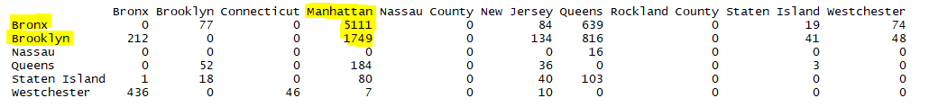
CART - Insights
The table below represents a subset of the ~29k Special Ed AM Run delays referenced on the previous slide
The delays in the table below occur when there are no students on the bus
Buses traveling in the morning from Bronx / Brooklyn to Manhattan report a delay occurring in Manhattan, before a student is picked up

Slide 15
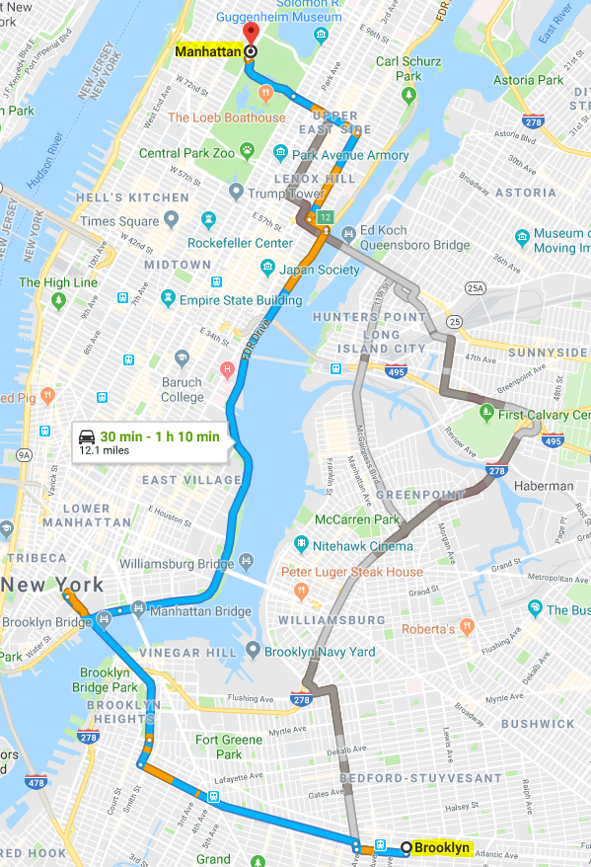
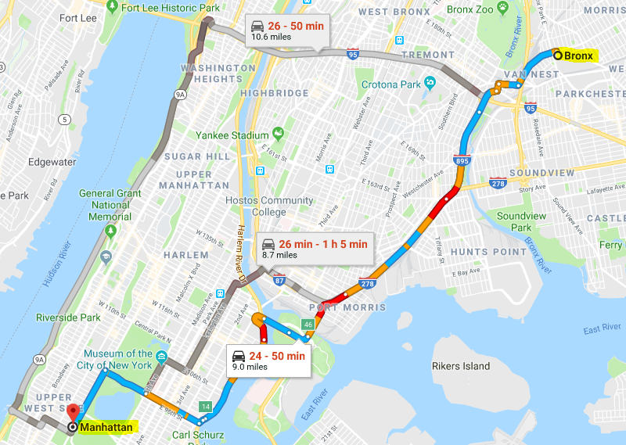
CART - Insights
Manhattan
Bronx
Multiple routes from Brooklyn / Bronx to Manhattan require crossing congested bridges / tollways
Traffic is only exacerbated during rush hour - are drivers getting stuck in these bottlenecks?
Manhattan
Image Sources: https://www.google.com/maps
Brooklyn

Slide 16
Negative Binomial Regression - Overview
Negative Binomial Regression
Similar to Poisson Regression, but is more appropriate when data exhibits over-dispersion (variance greater than mean)
Goal - Predict Count of Delays for each Borough, by day of week
Variables used
Independent: Borough of delay, Day of week (meta-feature)
Dependent: Count of Delays

Slide 17

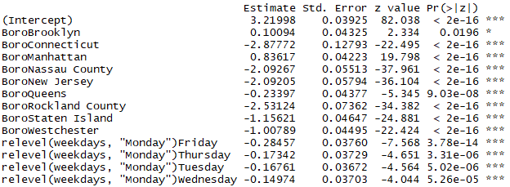

NBR - Results
In Scope Observations: ~5k unique daily counts by borough
Residual deviance less than d.o.f, indicating robust fit
Poisson: Residual deviance 22489 on 3489 degress of freedom
Negative binomial: Residual deviance 3401.4 on 3489 degress of freedom
Small Theta indicative of overdispersion (Var(X) = μ + (μ² /𝛳))
Theta: 2.8888
All predictors statistically significant
RMSE stable between train and holdout

Slide 18
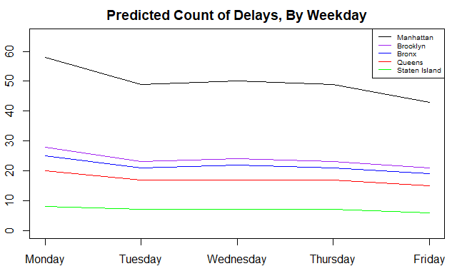
NBR - Predictions
Predictions indicate greatest number of delays occur on Mondays, naturally leading to the conclusion that Monday mornings have the greatest traffic

Slide 19
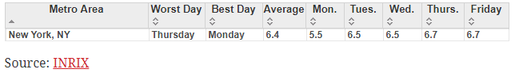
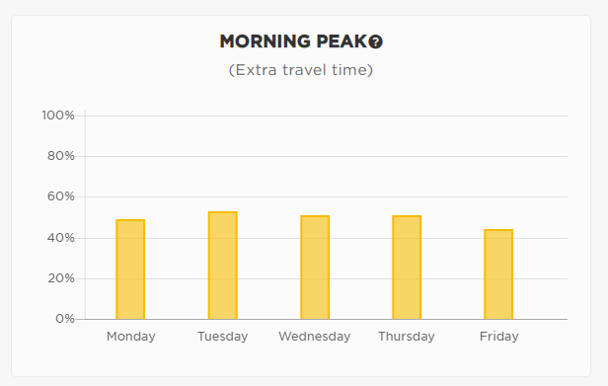
NBR - Insights
Multiple providers of traffic data analysis indicate Monday is not the worst day for traffic in NY
What is causing Monday to have the greatest number of morning delays?
Does parking configuration differ over weekends?
Is departure time in alignment?
Sources:
http://www.governing.com/gov-data/transportation-infrastructure/traffic-delay-by-day-metro-areas-cities.html
https://www.tomtom.com/en_gb/trafficindex/city/new-york

Slide 20
Recommendations and Future Work
Recommendation 1 - Consider alternate bus providers whose garages are in boroughs other than Bronx / Brooklyn to service schools in Manhattan
Recommendation 2 - Perform deep-dive study regarding Monday morning bus departures from garage
Does parking configuration differ over weekend, causing buses to depart from garages less efficiently?
Are bus departure times in alignment with optimal traffic patterns each day?
Recommendation 3 - Obtain more granular location information for delays (latitude / longitude) from GPS to identify local bottlenecks by Borough
Future Work - Use existing data and insights gained from above recommendations to perform route optimization
Source: http://arun-aiml.blogspot.com/2017/07/k-means-clustering.html

Slide 21
Q&A
Source: http://arun-aiml.blogspot.com/2017/07/k-means-clustering.html

